Slide 1
Cancer ——
The Emperor of All Maladies
Group Number : 16
Group Member : 王昊文 李岱峰
Student ID: 12132647 12132668

Slide 2
1
Research Problem
2
Literature Research
CONTENT
3
Method
4
Experimental Results and Conclusions
5
Difficulties and Limitations
6
Suggestions for the future work

Slide 3
1
Research Problem
Study the performance of the monocular slam algorithm in indoor and outdoor environments. It is evaluated by the performance of the tracking accuracy of the visual odometer.
Exploring the performance of monocular visual SLAM algorithms. We will compare ORB-SLAM2, DSO and LDSO to explore the influence of different methods on trajectory estimation.
Notes:
室内环境和室外环境有很大的不同，因为室外环境的光强变化比室内环境大得多。室外相机对高动态性能的要求更高，由于光线的变化，需要更多的自动曝光时间。另一方面，室外环境中的许多特征距离相机较远，这些特征对相机姿态有很好的约束，但可能不足以实现平移。对于室外的相机，大部分区域的光强几乎是恒定的，因此这些问题也出现在室内

Slide 4
1
Research Problem
Datasets: TUM-MONO & Kitti-Odometry (grayscale)
Algorithms (monocular): ORB-SLAM2 / DSO / LDSO (Original:ORB-SLAM2, ORB-SLAM3, OV2SLAM, and VINS-MONO)
Environments: Indoor & Outdoor
Performance metrics: Tracking accuracy (ATE & RPE)
Notes:
In our project, we will evaluate the performance of three monocular vision algorithms using kitti and TUM datasets. Different construction methods give them advantages and disadvantages in different situations.
In the indoor environment, the characteristics of the environment have a significant impact on exercise planning. In the outdoor environment, due to the poor outdoor light environment, the application of the camera is quite difficult. Moreover, the scope of outdoor environment is large, and the scope of feature point map or point cloud map constructed by vision is limited, which is a great challenge to monocular camera. We will verify the performance of the algorithm in different environments and compare it with existing results.

Slide 5
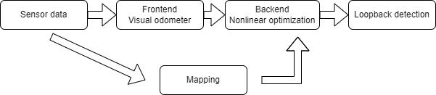
2
Literature Research
Fig. Visual SLAM system
A camera tracking frontend;
A backend that creates and maintains a map of keyframes;
Reduce global drift by loop closure detection and map optimization
The frontend may localize the camera globally against the current map, track the camera locally with visual (keyframe) odometry.
X. Gao, R. Wang, N. Demmel and D. Cremers, "LDSO: Direct Sparse Odometry with Loop Closure," 2018 IEEE/RSJ International Conference on Intelligent Robots and Systems (IROS), 2018, pp. 2198-2204, doi: 10.1109/IROS.2018.8593376.

Slide 6
2
Literature Research
Why monocular SLAM ?
Advantages
Low cost and low weight;
Switching seamlessly between differently scaled environments;
Drawbacks
Scale-ambiguity ( the major error sources)
Mingachev, E., Lavrenov, R., Tsoy, T., Matsuno, F., Svinin, M., Suthakorn, J., & Magid, E. (2020, October). Comparison of ros-based monocular visual slam methods: Dso, ldso, orb-slam2 and dynaslam. In International Conference on Interactive Collaborative Robotics (pp. 222-233). Springer, Cham.
Notes:
单目SLAM的主要特征之一是尺度模糊性[10]，这表明世界尺度无法观测到并随时间漂移，是主要的误差来源之一。
而立体或深度相机不允许这样的灵活性，有一个有限的范围，他们可以提供可靠的测量
(Stereo or Depth cameras have a limited range where they can provide reliable measurements )

Slide 7
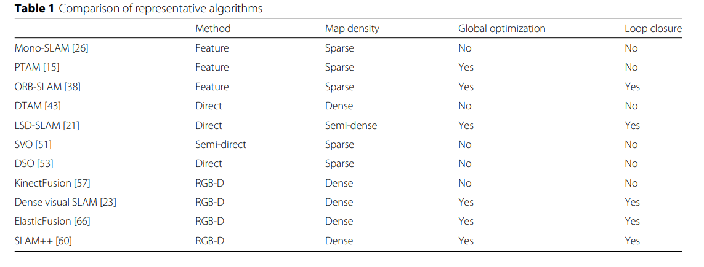
2
Literature Research
Taketomi, T., Uchiyama, H. & Ikeda, S. Visual SLAM algorithms: a survey from 2010 to 2016. IPSJ T Comput Vis Appl 9, 16 (2017). https://doi.org/10.1186/s41074-017-0027-2

Slide 8
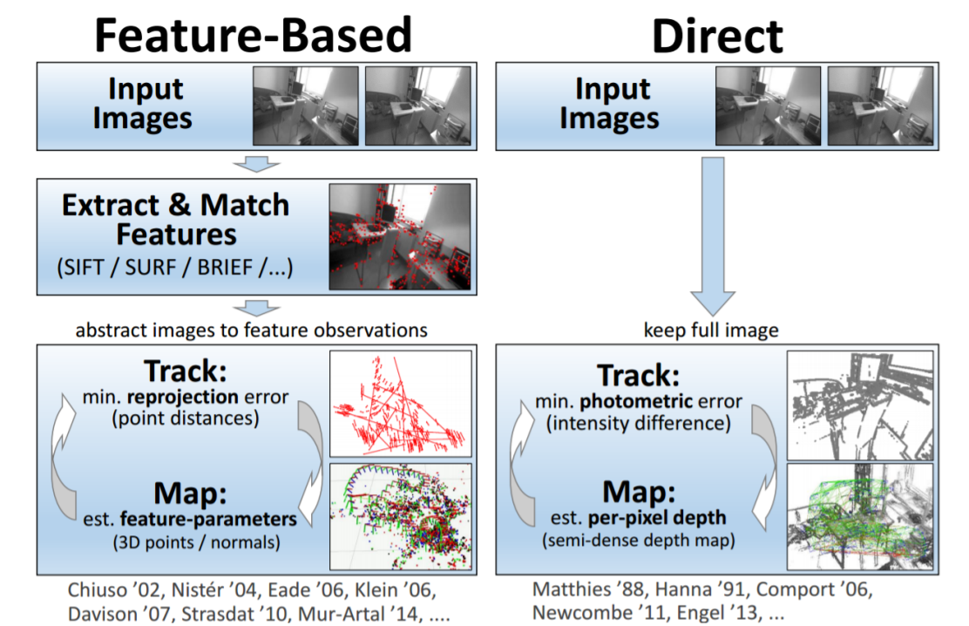
2
Literature Research
http://wavelab.uwaterloo.ca/slam/2017-SLAM/Lecture14-Direct_visual_inertial_odometry_and_SLAM/slides.pdf
Notes:
直接方法通过直接最小化光度误差和光流正则化来估计完全密集重建。一些直接的方法集中在高梯度地区估计半密集的地图[2]。
基于特征的方法依赖于关键点的匹配，并且只能估计一个稀疏重构[3]，主要提供了一个准确性和运行时间之间的良好权衡。
特征点法通过最小化重投影误差来计算相机位姿与地图点的位置，而直接法则最小化光度误差（photometric error）。所谓光度误差是说，最小化的目标函数，通常由图像之间的误差来决定，而非重投影之后的几何误差。
直接法将数据关联（data association）与位姿估计（pose estimation）放在了一个统一的非线性优化问题中，而特征点法则分步求解，即，先通过匹配特征点求出数据之间关联，再根据关联来估计位姿。这两步通常是独立的，在第二步中，可以通过重投影误差来判断数据关联中的外点，也可以用于修正匹配结果（例如[6]中提到的类EM的方法）。

Slide 9
2
Literature Research
The Selected SLAM Methods
Direct Methods
DSO, which is a state-of-the-art pure direct method
LDSO, which is DSO’s latest revision with a loop closure ability and a global map optimization
Feature-Based Methods
ORB-SLAM2:state-of-the-art visual SLAM method that tracks ORB features in real-time.
Mingachev, E., Lavrenov, R., Tsoy, T., Matsuno, F., Svinin, M., Suthakorn, J., & Magid, E. (2020, October). Comparison of ros-based monocular visual slam methods: Dso, ldso, orb-slam2 and dynaslam. In International Conference on Interactive Collaborative Robotics (pp. 222-233). Springer, Cham.

Slide 10
2
Literature Research
Benchmarks
TUM-Mono
Including 50 indoor and outdoor sequences;
All sequences are photometrically calibrated and provide exposure times for each frame;
Evaluating a tracking accuracy via an accumulated drift and a reliably benchmark direct methods.
Kitti Odometry Dataset
Large - scale scenarios make the monocular VO system suffer severe accumulated drift.
To see the potential of these monocular method after the integration of the loop closure functionality.
Notes:
数据集包括50个室内和室外序列，它们的起始和结束位置相同，仅包含这些起始和结束轨迹片段的真值
所有数据集序列都经过光度校准，并根据传感器、相机响应函数和密集镜头衰减因子报告为每一帧提供曝光时间。
这允许通过累积漂移和可靠的基准直接方法来评估跟踪精度
在KITTI测程数据集上，单目VO系统，如DSO和ORB-SLAM(仅VO组件)遭受了严重的累积漂移，这使得它们不能用于如此大规模的场景。 这里我们想看到我们的单眼方法的潜力，在集成了回环

Slide 11
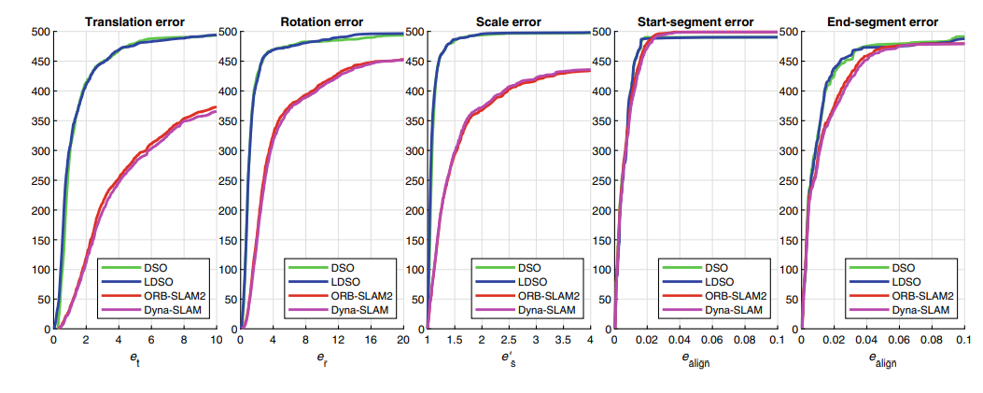
2
Literature Research
Existing Findings -- Cumulative error graphs (TUM)
Fig. Accumulated translational ($e_{t}$,m), rotational ($e_{r}$,m), and scale ($e_{s}′$,m) drifts along with the start and end segments RMSE ($e_{align}$,m),
Notes:
图给出了累积误差图——当将估计的轨迹起始和结束段与提供的地面真实轨迹对齐时，累积的平移、旋转和尺度漂移随RMSE的变化。
x轴是错误阈值，y轴是错误低于阈值的运行次数。该图描述了错误低于相应的x值的运行次数——越接近左上角越好。
由于真值数据和实验结果的相似性，

Slide 12
2
Literature Research
Existing Conclusions
Engel et al. concluded that almost all of the alignment errors originate not from the noise in the groundtruth, but from the accumulated drift.
The experiments demonstrated that direct methods provide outstanding results comparing to the feature-based ones
The TUM-Mono dataset is designed especially for direct methods benchmark purposes, providing full photometric data for each frame, which greatly improves the accuracy of such methods.
Mingachev, E., Lavrenov, R., Tsoy, T., Matsuno, F., Svinin, M., Suthakorn, J., & Magid, E. (2020, October). Comparison of ros-based monocular visual slam methods: Dso, ldso, orb-slam2 and dynaslam. In International Conference on Interactive Collaborative Robotics (pp. 222-233). Springer, Cham.
Notes:
Engel等人的结论是，几乎所有的对准误差都不是来自地面真实中的噪声，而是来自累积漂移。我实验证实了这一结论，这意味着这些指标可以用于任何具有任何精度的基准作为参考，即使是使用SLAM算法收集的基准。
实验表明，与基于特征的方法相比，直接方法可以获得更好的结果——tumi - mono数据集是专门为直接方法基准设计的，为每一帧提供完整的光度数据，大大提高了直接方法的准确性。然而，如果比较DSO和LDSO并没有太大的区别——正如我们可以假设的那样，LDSO全局地图优化稍微提高了基本方法的整体精度。

Slide 13
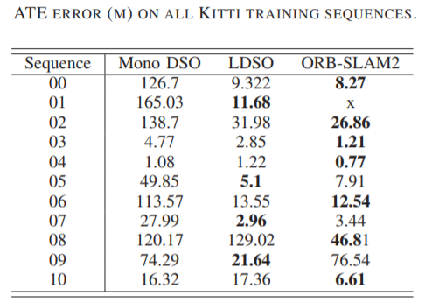
2
Literature Research
Existing Findings (Kitti)
X. Gao, R. Wang, N. Demmel and D. Cremers, "LDSO: Direct Sparse Odometry with Loop Closure," 2018 IEEE/RSJ International Conference on Intelligent Robots and Systems (IROS), 2018, pp. 2198-2204, doi: 10.1109/IROS.2018.8593376.
Notes:
对于带有循环的序列(seq00,05,07)， LDSO大大提高了DSO的性能

Slide 14
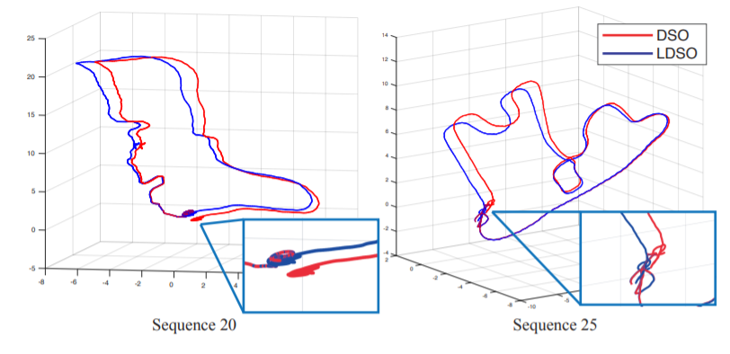
2
Literature Research
Existing Findings
Fig. Trajectories in TUM-Mono dataset. The red line is the estimated trajectory by original DSO where we can see obvious drift. The blue line is the loop-closed trajectory
X. Gao, R. Wang, N. Demmel and D. Cremers, "LDSO: Direct Sparse Odometry with Loop Closure," 2018 IEEE/RSJ International Conference on Intelligent Robots and Systems (IROS), 2018, pp. 2198-2204, doi: 10.1109/IROS.2018.8593376.
Notes:
为了显示一些定性的结果，我们还在tumi - mono上运行带闭环的LDSO，得到一些Sim(3)闭合轨迹

Slide 15
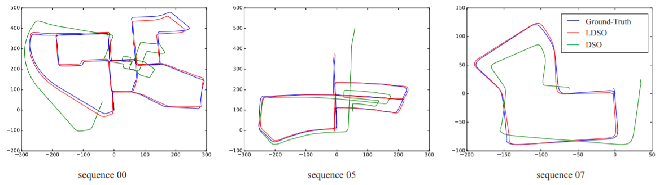
2
Literature Research
Existing Findings
Fig. Sim(3) aligned trajectories of Kitti sequence 00,05 and 07, which contains closed loops.
X. Gao, R. Wang, N. Demmel and D. Cremers, "LDSO: Direct Sparse Odometry with Loop Closure," 2018 IEEE/RSJ International Conference on Intelligent Robots and Systems (IROS), 2018, pp. 2198-2204, doi: 10.1109/IROS.2018.8593376.
Notes:
对于带有循环的序列(seq00,05,07)， LDSO大大提高了DSO的性能

Slide 16
3
Method
EVO tool
evo_ape - absolute pose error;
evo_rpe - relative pose error;
evo_traj - tool for analyzing, plotting or exporting one or more trajectories;
evo_res - tool for comparing one or multiple result files from evo_ape or evo_rpe;
evo_fig - (experimental) tool for re-opening serialized plots (saved with --serialize_plot);
evo_config - tool for global settings and config file manipulation;
https://github.com/MichaelGrupp/evo https://blog.csdn.net/A_L_A_N/article/details/88708979
Notes:
When our body cell begin to divide, telomere will disappear a little by little during the chromosome’s duplication. When it’s totally gone , the cell dies. But what does this have to do with cancer?

Slide 17
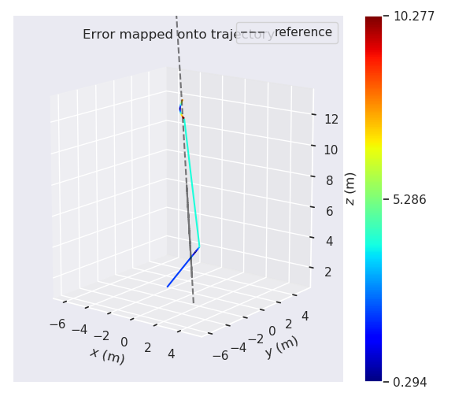
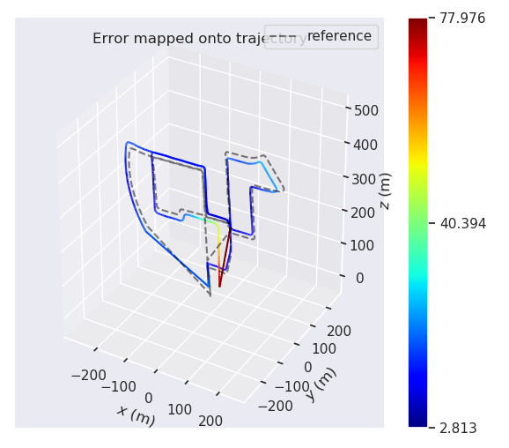
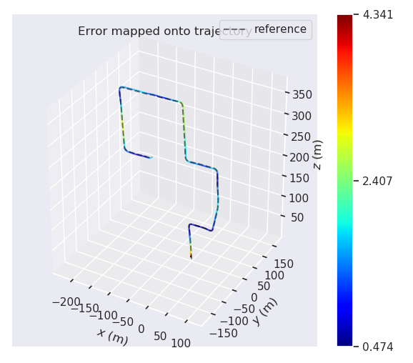
4
Experimental Results and Conclusions
Notes:
When our body cell begin to divide, telomere will disappear a little by little during the chromosome’s duplication. When it’s totally gone , the cell dies. But what does this have to do with cancer?

Slide 18
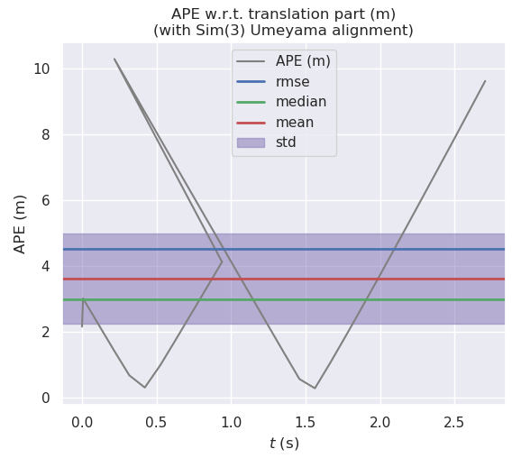
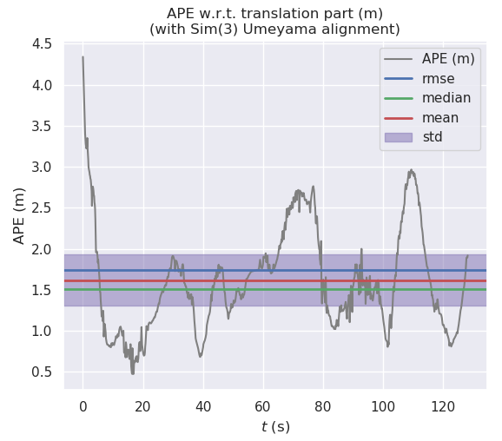
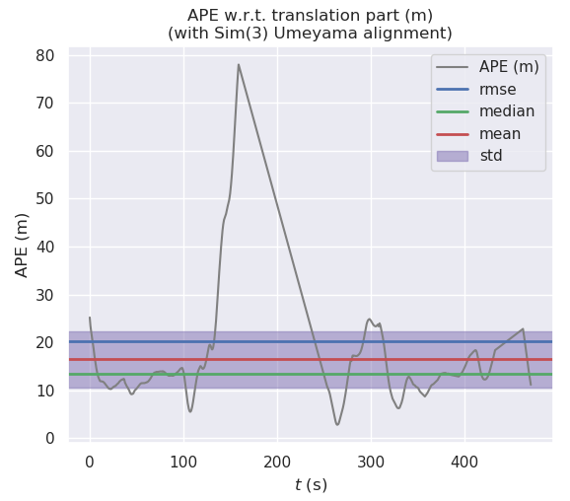
4
Experimental Results and Conclusions
Notes:
When our body cell begin to divide, telomere will disappear a little by little during the chromosome’s duplication. When it’s totally gone , the cell dies. But what does this have to do with cancer?

Slide 19
4
Experimental Results and Conclusions
Notes:
When our body cell begin to divide, telomere will disappear a little by little during the chromosome’s duplication. When it’s totally gone , the cell dies. But what does this have to do with cancer?

Slide 20
4
Experimental Results and Conclusions
Conclusions
The direct methods performs better than the feature-based method in alignment error, accumulated drift;
The direct methods have higher value of absolute trajectory error than feature-based methods (worse global accuracy)
The direct methods have lower value of relative position error than feature-based methods (better local accuracy)
The direct methods typically distinguish more keyframes and, thus, having a better local (pose) accuracy, compared to feature-based methods.
Notes:
When our body cell begin to divide, telomere will disappear a little by little during the chromosome’s duplication. When it’s totally gone , the cell dies. But what does this have to do with cancer?

Slide 21
5
Difficulties and Limitations
Difficulties
Ov2slam algorithm needs to convert kitti data sequence into rosbag form, but we can’t find clearly introduction;
Data format problem, different algorithms output data form has great difference. We even had to modify the source code;
Environment configuration;
For the problem that can make the orbslam2 algorithm run successfully under the TUM-MONO datasets, we have still not found a suitable solution.
Notes:
When our body cell begin to divide, telomere will disappear a little by little during the chromosome’s duplication. When it’s totally gone , the cell dies. But what does this have to do with cancer?

Slide 22
5
Difficulties and Limitations
Limitations
Using more evaluation indicators for a comprehensive analysis. For example, we could use the color-coded alignment RMSE ranging from 0 (blue) to 10 m (red) for each dataset sequence;
As we have not found a way to run orbslam2 under the TUM-MONO data set, we have not been able to reproduce the existing results well. As a result, the comparison of the three algorithms on the TUM data set is insufficient.
Notes:
When our body cell begin to divide, telomere will disappear a little by little during the chromosome’s duplication. When it’s totally gone , the cell dies. But what does this have to do with cancer?

Slide 23
6
Suggestions for the future work
3.1. Problems 1) Feature dependence Visual SLAM has a very serious dependence on environmental features. Feature extraction and matching in weak texture environments, loop detection, etc. will all be affected by it. To solve this kind of problem, you can introduce more advanced features such as line features, surface features, super pixel features; another method is to add other types of sensors such as laser or IMU, which can combine the features of several different sensors to achieve higher Precision and robustness. 2) Real-time SLAM is called real-time positioning and mapping technology, and real-time is always an issue that needs to be considered. This is related to the speed at which the robot completes tasks in an unfamiliar environment. To solve the real-time problem, it is necessary to consider the complexity of the algorithm, as well as the problem of reducing the computational complexity of large-scale scenes by means of sub-maps.

Slide 24
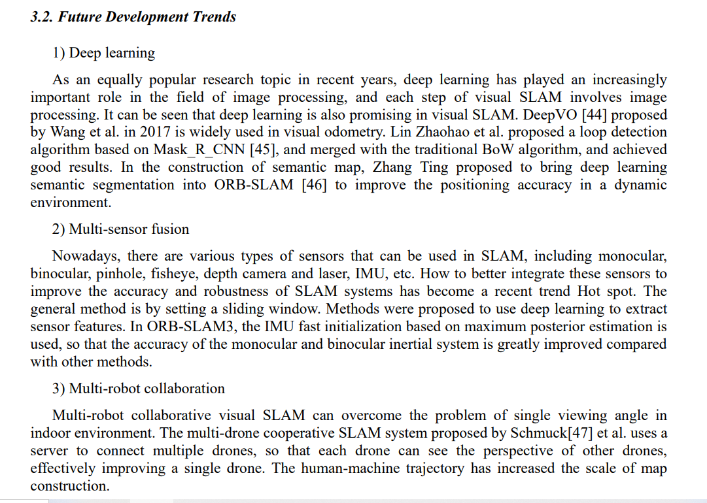
Suggestions for the future work

Slide 25

Thanks for Listening

